Slide 1
MICROPROGRAMMED CONTROL
Microprogrammed Control
  Control Memory
  Sequencing Microinstructions
  Microprogram Example
  Design of Control Unit
  Microinstruction Format
  Nanostorage and Nanoprogram

Slide 2
COMPARISON OF CONTROL UNIT IMPLEMENTATIONS
Microprogrammed Control
Implementation of Control Unit
Control Unit Implementation
Combinational Logic Circuits (Hard-wired)
Control Data
Memory
I R
Status F/Fs
Control Unit's State
Timing State
Combinational
Control
Logic Circuits
Points
CPU
Ins. Cycle State
Microprogram
M
Control Data
e
m
Status F/Fs
o
I R
r
y
C
Control
C
C
Next Address
S
Storage
S
D
P
CPU
Generation
A
(μ-program
D
s
Logic
R
memory)
R
}

Slide 3
TERMINOLOGY
Microprogrammed Control
Microprogram
- Program stored in memory that generates all the control signals required
to execute the instruction set correctly
- Consists of microinstructions
Microinstruction
- Contains a control word and a sequencing word
Control Word - All the control information required for one clock cycle
Sequencing Word - Information needed to decide
the next microinstruction address
- Vocabulary to write a microprogram
Control Memory(Control Storage: CS)
- Storage in the microprogrammed control unit to store the microprogram
Writeable Control Memory(Writeable Control Storage:WCS)
- CS whose contents can be modified
-> Allows the microprogram can be changed
-> Instruction set can be changed or modified
Dynamic Microprogramming
- Computer system whose control unit is implemented with
a microprogram in WCS
- Microprogram can be changed by a systems programmer or a user

Slide 4
TERMINOLOGY
Microprogrammed Control
Sequencer (Microprogram Sequencer)
A Microprogram Control Unit that determines
the Microinstruction Address to be executed
in the next clock cycle
- In-line Sequencing
- Branch
- Conditional Branch
- Subroutine
- Loop
- Instruction OP-code mapping

Slide 5
MICROINSTRUCTION SEQUENCING
Microprogrammed Control
Sequencing
Instruction code
Mapping
logic
Status
bits
Branch
MUX
Multiplexers
logic
select
Subroutine
register
(SBR)
Control address register
(CAR)
Incrementer
Control memory (ROM)
select a status
bit
Branch address
Microoperations
Sequencing Capabilities Required in a Control Storage
- Incrementing of the control address register
- Unconditional and conditional branches
- A mapping process from the bits of the machine
instruction to an address for control memory
- A facility for subroutine call and return

Slide 6
CONDITIONAL BRANCH
Microprogrammed Control
Sequencing
Load address
Control address register
Increment
MUX
Control memory
...
Status
(condition)
bits
Condition select
Micro-operations
Next address
Conditional Branch
If Condition is true, then Branch (address from
the next address field of the current microinstruction)
else Fall Through
Conditions to Test: O(overflow), N(negative),
Z(zero), C(carry), etc.
Unconditional Branch
Fixing the value of one status bit at the input of the multiplexer to 1

Slide 7
MAPPING OF INSTRUCTIONS
Microprogrammed Control
Sequencing
Direct Mapping
Address
OP-codes of Instructions
0000
0001
0010
0011
0100
ADD Routine
ADD
AND
LDA
STA
BUN
0000
0001
0010
0011
0100
AND Routine
.
.
.
LDA Routine
STA Routine
BUN Routine
Control
Storage
Mapping
Bits
10 xxxx 010
Address
10 0000 010
ADD Routine
10 0001 010
AND Routine
10 0010 010
LDA Routine
10 0011 010
STA Routine
10 0100 010
BUN Routine

Slide 8
MAPPING OF INSTRUCTIONS TO MICROROUTINES
Microprogrammed Control
Sequencing
Mapping from the OP-code of an instruction to the
address of the Microinstruction which is the starting
microinstruction of its execution microprogram
Machine
Instruction
OP-code
1 0 1 1 Address
Mapping bits
0 x x x x 0 0
0 1 0 1 1 0 0
Microinstruction
address
Mapping function implemented by ROM or PLA
OP-code
Mapping memory
(ROM or PLA)
Control address register
Control Memory

Slide 9
MICROPROGRAM EXAMPLE
Microprogrammed Control
Microprogram
Computer Configuration
MUX
10
0
AR
Address
Memory
10
0
2048 x 16
PC
MUX
6
0
6
0
15
0
DR
SBR
CAR
Control memory
Arithmetic
logic and
shift unit
128 x 20
Control unit
15
0
AC

Slide 10
MACHINE INSTRUCTION FORMAT
Microprogrammed Control
Microprogram
Machine instruction format
15
14
11
10
0
I
Opcode
Address
Sample machine instructions
Symbol OP-code Description
EA is the effective address
  ADD 0000 AC ← AC + M[EA]
  BRANCH 0001 if (AC < 0) then (PC ← EA)
  STORE 0010 M[EA] ← AC
  EXCHANGE 0011 AC ← M[EA], M[EA] ← AC
Microinstruction Format
3
3
3
2
2
7
F1
F2
F3
CD
BR
AD
F1, F2, F3: Microoperation fields
CD: Condition for branching
BR: Branch field
AD: Address field

Slide 11
MICROINSTRUCTION FIELD DESCRIPTIONS - F1,F2,F3
Microprogrammed Control
Microprogram
F1 Microoperation Symbol
000 None NOP
001 AC ← AC + DR ADD
010 AC ← 0 CLRAC
011 AC ← AC + 1 INCAC
100 AC ← DR DRTAC
101 AR ← DR(0-10) DRTAR
110 AR ← PC PCTAR
111 M[AR] ← DR WRITE
F2 Microoperation Symbol
000 None NOP
001 AC ← AC - DR SUB
010 AC ← AC ∨ DR OR
011 AC ← AC ∧ DR AND
100 DR ← M[AR] READ
101 DR ← AC ACTDR
110 DR ← DR + 1 INCDR
111 DR(0-10) ← PC PCTDR
F3 Microoperation Symbol
000 None NOP
001 AC ← AC ⊕ DR XOR
010 AC ← AC’ COM
011 AC ← shl AC SHL
100 AC ← shr AC SHR
101 PC ← PC + 1 INCPC
110 PC ← AR ARTPC
111 Reserved

Slide 12
MICROINSTRUCTION FIELD DESCRIPTIONS - CD, BR
Microprogrammed Control
Microprogram
CD Condition Symbol Comments
00 Always = 1 U Unconditional branch
01 DR(15) I Indirect address bit
10 AC(15) S Sign bit of AC
11 AC = 0 Z Zero value in AC
  BR Symbol Function
  00 JMP CAR ← AD if condition = 1
  CAR ← CAR + 1 if condition = 0
  01 CALL CAR ← AD, SBR ← CAR + 1 if condition = 1
  CAR ← CAR + 1 if condition = 0
  10 RET CAR ← SBR (Return from subroutine)
  11 MAP CAR(2-5) ← DR(11-14), CAR(0,1,6) ← 0

Slide 13
SYMBOLIC MICROINSTRUCTIONS
Microprogrammed Control
Microprogram
Symbols are used in microinstructions as in assembly language
A symbolic microprogram can be translated into its binary equivalent by a microprogram assembler.
Sample Format
five fields: label; micro-ops; CD; BR; AD
  Label: may be empty or may specify a symbolic address terminated with a colon
  Micro-ops: consists of one, two, or three symbols
  separated by commas
  CD: one of {U, I, S, Z}, where U: Unconditional Branch
  I: Indirect address bit
  S: Sign of AC
  Z: Zero value in AC
  BR: one of {JMP, CALL, RET, MAP}
  AD: one of {Symbolic address, NEXT, empty}

Slide 14
SYMBOLIC MICROPROGRAM - FETCH ROUTINE
Microprogrammed Control
Microprogram
During FETCH, Read an instruction from memory
and decode the instruction and update PC
Sequence of microoperations in the fetch cycle:
AR ← PC
DR ← M[AR], PC ← PC + 1
AR ← DR(0-10), CAR(2-5) ← DR(11-14), CAR(0,1,6) ← 0
Symbolic microprogram for the fetch cycle:
FETCH:
ORG 64
PCTAR U JMP NEXT
READ, INCPC U JMP NEXT
DRTAR U MAP
Binary equivalents translated by an assembler
Binary
address F1 F2 F3 CD BR AD
1000000 110 000 000 00 00 1000001
1000001 000 100 101 00 00 1000010
1000010 101 000 000 00 11 0000000

Slide 15
SYMBOLIC MICROPROGRAM
Microprogrammed Control
Microprogram
Control Storage: 128 20-bit words
The first 64 words: Routines for the 16 machine instructions
The last 64 words: Used for other purpose (e.g., fetch routine and other subroutines)
Mapping: OP-code XXXX into 0XXXX00, the first address for the 16 routines are
0(0 0000 00), 4(0 0001 00), 8, 12, 16, 20, ..., 60
Partial Symbolic Microprogram
Label Microops CD BR AD
ADD:
BRANCH:
OVER:
STORE:
EXCHANGE:
FETCH:
INDRCT:
ORG 0
NOP
READ
ADD
ORG 4
NOP
NOP
NOP
ARTPC
ORG 8
NOP
ACTDR
WRITE
ORG 12
NOP
READ
ACTDR, DRTAC
WRITE
ORG 64
PCTAR
READ, INCPC
DRTAR
READ
DRTAR
I
U
U
S
U
I
U
I
U
U
I
U
U
U
U
U
U
U
U
CALL
JMP
JMP
JMP
JMP
CALL
JMP
CALL
JMP
JMP
CALL
JMP
JMP
JMP
JMP
JMP
MAP
JMP
RET
INDRCT
NEXT
FETCH
OVER
FETCH
INDRCT
FETCH
INDRCT
NEXT
FETCH
INDRCT
NEXT
NEXT
FETCH
NEXT
NEXT
NEXT

Slide 16
BINARY MICROPROGRAM
Microprogrammed Control
Microprogram
  Address Binary Microinstruction
  Micro Routine Decimal Binary F1 F2 F3 CD BR AD
ADD 0 0000000 000 000 000 01 01 1000011
  1 0000001 000 100 000 00 00 0000010
  2 0000010 001 000 000 00 00 1000000
  3 0000011 000 000 000 00 00 1000000
BRANCH 4 0000100 000 000 000 10 00 0000110
  5 0000101 000 000 000 00 00 1000000
  6 0000110 000 000 000 01 01 1000011
  7 0000111 000 000 110 00 00 1000000
STORE 8 0001000 000 000 000 01 01 1000011
  9 0001001 000 101 000 00 00 0001010
  10 0001010 111 000 000 00 00 1000000
  11 0001011 000 000 000 00 00 1000000
EXCHANGE 12 0001100 000 000 000 01 01 1000011
  13 0001101 001 000 000 00 00 0001110
  14 0001110 100 101 000 00 00 0001111
  15 0001111 111 000 000 00 00 1000000
FETCH 64 1000000 110 000 000 00 00 1000001
  65 1000001 000 100 101 00 00 1000010
  66 1000010 101 000 000 00 11 0000000
INDRCT 67 1000011 000 100 000 00 00 1000100
  68 1000100 101 000 000 00 10 0000000
This microprogram can be implemented using ROM

Slide 17
DESIGN OF CONTROL UNIT
- DECODING ALU CONTROL INFORMATION -
Microprogrammed Control
Design of Control Unit
microoperation fields
F1
F2
F3
3 x 8 decoder
3 x 8 decoder
3 x 8 decoder
7
6
5
4
3
2
1
0
7
6
5
4
3
2
1
0
7
6
5
4
3
2
1
0
AND
AC
DR
ADD
Arithmetic
DRTAC
logic and
shift unit
From
From
PCTAR
DRTAR
PC
DR(0-10)
Load
AC
Select
0
1
Multiplexers
Load
AR
Clock
Decoding of Microoperation Fields

Slide 18
MICROPROGRAM SEQUENCER
- NEXT MICROINSTRUCTION ADDRESS LOGIC -
Microprogrammed Control
Design of Control Unit
Branch, CALL Address
External
RETURN form Subroutine
(MAP)
In-Line
S₁S₀ Address Source
00 CAR + 1, In-Line
01 SBR RETURN
10 CS(AD), Branch or CALL
11 MAP
3
2
1
0
L
S
SBR
Subroutine
CALL
1
MUX1
S
0
Address
source
selection
Incrementer
Clock
CAR
Control Storage
MUX-1 selects an address from one of four sources and routes it into a CAR
- In-Line Sequencing → CAR + 1
- Branch, Subroutine Call → CS(AD)
- Return from Subroutine → Output of SBR
- New Machine instruction → MAP

Slide 19
MICROPROGRAM SEQUENCER
- CONDITION AND BRANCH CONTROL -
Microprogrammed Control
Design of Control Unit
From
CPU
1
Test
L
L(load SBR with PC) for subroutine Call
I
MUX2
T
S
BR field
of CS
Input
Z
Select
I₀
logic
S₀
S₁
for next address
selection
I₁
CD Field of CS
Input Logic
I₁I₀T Meaning Source of Address S₁S₀ L
000 In-Line CAR+1 00 0
001 JMP CS(AD) 01 0
010 In-Line CAR+1 00 0
011 CALL CS(AD) and SBR <- CAR+1 01 1
10x RET SBR 10 0
11x MAP DR(11-14) 11 0
S₁ = I₁
S₀ = I₁I₀ + I₁’T
L = I₁’I₀T

Slide 20
MICROPROGRAM SEQUENCER
Microprogrammed Control
Design of Control Unit
External
(MAP)
I₀
L
3
2
1
0
I₁
Input
S₁
SBR
Load
logic
S₀
MUX1
T
1
Incrementer
I
MUX2
Test
S
Z
Select
Clock
CAR
Control memory
Microops
CD
BR
AD
. . .
. . .

Slide 21
MICROINSTRUCTION FORMAT
Microprogrammed Control
Microinstruction Format
Information in a Microinstruction
- Control Information
- Sequencing Information
- Constant
Information which is useful when feeding into the system
These information needs to be organized in some way for
- Efficient use of the microinstruction bits
- Fast decoding
Field Encoding
- Encoding the microinstruction bits
- Encoding slows down the execution speed
due to the decoding delay
- Encoding also reduces the flexibility due to
the decoding hardware

Slide 22
HORIZONTAL AND VERTICAL
MICROINSTRUCTION FORMAT
Microprogrammed Control
Microinstruction Format
Horizontal Microinstructions
Each bit directly controls each micro-operation or each control point
Horizontal implies a long microinstruction word
Advantages: Can control a variety of components operating in parallel.
--> Advantage of efficient hardware utilization
Disadvantages: Control word bits are not fully utilized
--> CS becomes large --> Costly
Vertical Microinstructions
A microinstruction format that is not horizontal
Vertical implies a short microinstruction word
Encoded Microinstruction fields
--> Needs decoding circuits for one or two levels of decoding
One-level decoding
Two-level decoding
Field A
Field B
Field A
Field B
2 bits
3 bits
2 bits
6 bits
2 x 4
3 x 8
2 x 4
6 x 64
Decoder
Decoder
Decoder
Decoder
1 of 4
1 of 8
Decoder and
selection logic

Slide 23
NANOSTORAGE AND NANOINSTRUCTION
Microprogrammed Control
Control Storage Hierarchy
The decoder circuits in a vertical microprogram
storage organization can be replaced by a ROM
=> Two levels of control storage
First level - Control Storage
Second level - Nano Storage
Two-level microprogram
First level
-Vertical format Microprogram
Second level
-Horizontal format Nanoprogram
- Interprets the microinstruction fields, thus converts a vertical microinstruction format into a horizontal nanoinstruction format.
Usually, the microprogram consists of a large number of short microinstructions, while the nanoprogram contains fewer words with longer nanoinstructions.

Slide 24
TWO-LEVEL MICROPROGRAMMING - EXAMPLE
Microprogrammed Control
Control Storage Hierarchy
* Microprogram: 2048 microinstructions of 200 bits each
* With 1-Level Control Storage: 2048 x 200 = 409,600 bits
* Assumption:
256 distinct microinstructions among 2048
* With 2-Level Control Storage:
Nano Storage: 256 x 200 bits to store 256 distinct nanoinstructions
Control storage: 2048 x 8 bits
To address 256 nano storage locations 8 bits are needed
* Total 1-Level control storage: 409,600 bits
Total 2-Level control storage: 67,584 bits (256 x 200 + 2048 x 8)
Control address register
11 bits
Control memory
2048 x 8
Microinstruction (8 bits)
Nanomemory address
Nanomemory
256 x 200
Nanoinstructions (200 bits)

Slide 25
Overview
Central Processing Unit
Instruction Set Processor (ISP)
Central Processing Unit (CPU)
A typical computing task consists of a series of steps specified by a sequence of machine instructions that constitute a program.
An instruction is executed by carrying out a sequence of more rudimentary operations.

Slide 26
Fundamental Concepts
Central Processing Unit
Processor fetches one instruction at a time and perform the operation specified.
Instructions are fetched from successive memory locations until a branch or a jump instruction is encountered.
Processor keeps track of the address of the memory location containing the next instruction to be fetched using Program Counter (PC).
Instruction Register (IR)

Slide 27
Executing an Instruction
Central Processing Unit
Fetch the contents of the memory location pointed to by the PC. The contents of this location are loaded into the IR (fetch phase).
IR ← [[PC]]
Assuming that the memory is byte addressable, increment the contents of the PC by 4 (fetch phase).
PC ← [PC] + 4
Carry out the actions specified by the instruction in the IR (execution phase).

Slide 28
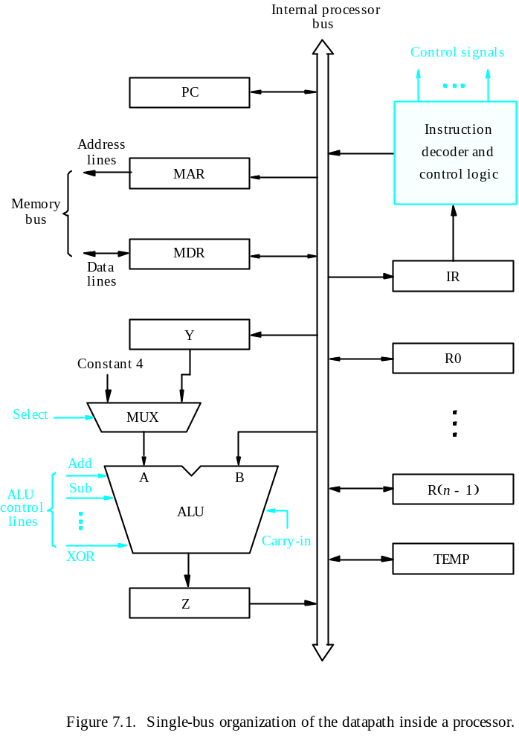
Processor Organization
Central Processing Unit
MDR HAS TWO INPUTS AND TWO OUTPUTS
Datapath
Textbook Page 413

Slide 29
Executing an Instruction
Central Processing Unit
Transfer a word of data from one processor register to another or to the ALU.
Perform an arithmetic or a logic operation and store the result in a processor register.
Fetch the contents of a given memory location and load them into a processor register.
Store a word of data from a processor register into a given memory location.

Slide 30
Register Transfers
Central Processing Unit
Internal processor
b
us
R
i
in
R
i
R
i
out
Y
in
Y
Constant 4
Select
MUX
A
B
ALU
Z
in
Z
Z
out
Figure 7.2. Input and output gating for the registers in Figure 7.1.

Slide 31
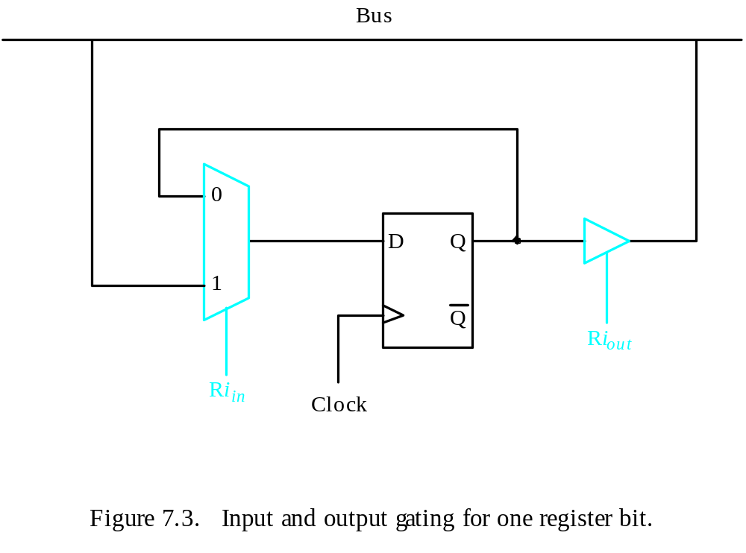
Register Transfers
Central Processing Unit
All operations and data transfers are controlled by the processor clock.
Figure 7.3. Input and output gating for one register bit.

Slide 32
Performing an Arithmetic or Logic Operation
Central Processing Unit
The ALU is a combinational circuit that has no internal storage.
ALU gets the two operands from MUX and bus. The result is temporarily stored in register Z.
What is the sequence of operations to add the contents of register R1 to those of R2 and store the result in R3?
  R1out, Yin
  R2out, SelectY, Add, Zin
  Zout, R3in

Slide 33
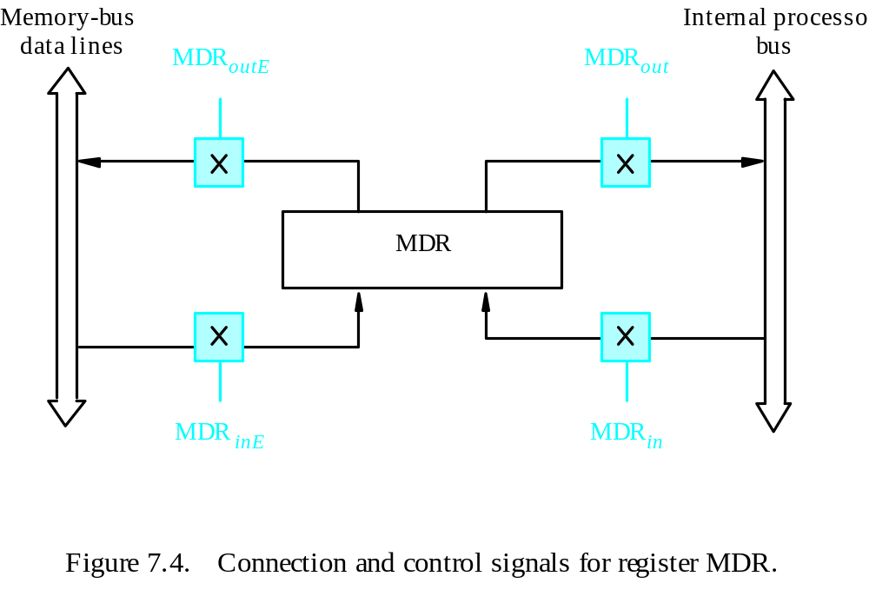
Fetching a Word from Memory
Central Processing Unit
Address into MAR; issue Read operation; data into MDR.
Figure 7.4. Connection and control signals for register MDR.

Slide 34
Fetching a Word from Memory
Central Processing Unit
The response time of each memory access varies (cache miss, memory-mapped I/O,…).
To accommodate this, the processor waits until it receives an indication that the requested operation has been completed (Memory-Function-Completed, MFC).
Move (R1), R2
MAR ← [R1]
Start a Read operation on the memory bus
Wait for the MFC response from the memory
Load MDR from the memory bus
R2 ← [MDR]

Slide 35
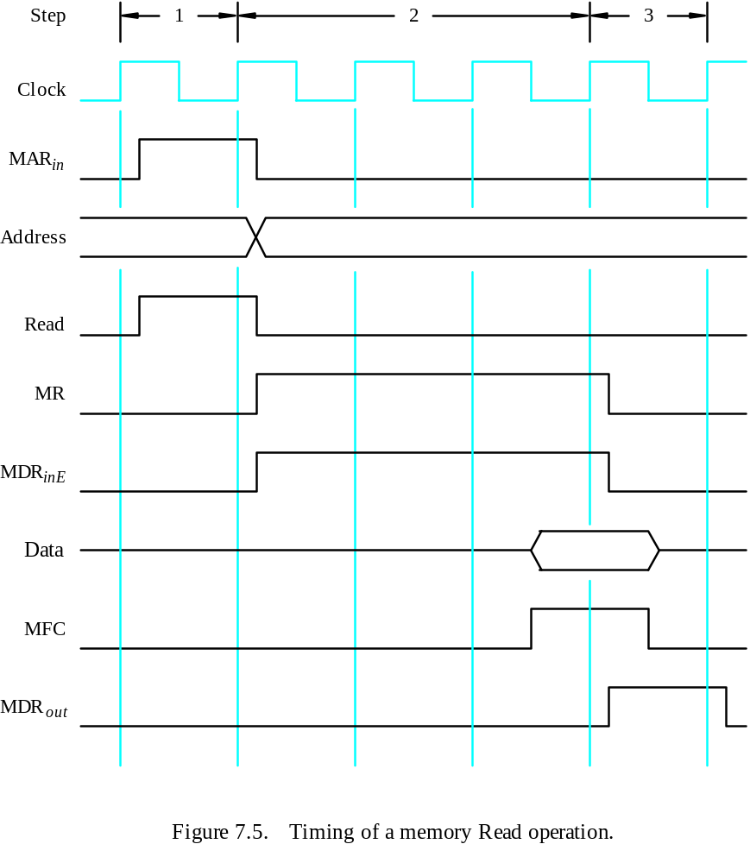
Timing
Central Processing Unit
MAR ← [R1]
Assume MAR
is always available
on the address lines
of the memory bus.
Start a Read operation on the memory bus
Wait for the MFC response from the memory
Load MDR from the memory bus
R2 ← [MDR]

Slide 36
Execution of a Complete Instruction
Central Processing Unit
Add (R3), R1
Fetch the instruction
Fetch the first operand (the contents of the memory location pointed to by R3)
Perform the addition
Load the result into R1

Slide 37
Architecture
Central Processing Unit
Internal processor
b
us
R
i
in
R
i
R
i
out
Y
in
Y
Constant 4
Select
MUX
A
B
ALU
Z
in
Z
Z
out
Figure 7.2. Input and output gating for the registers in Figure 7.1.

Slide 38
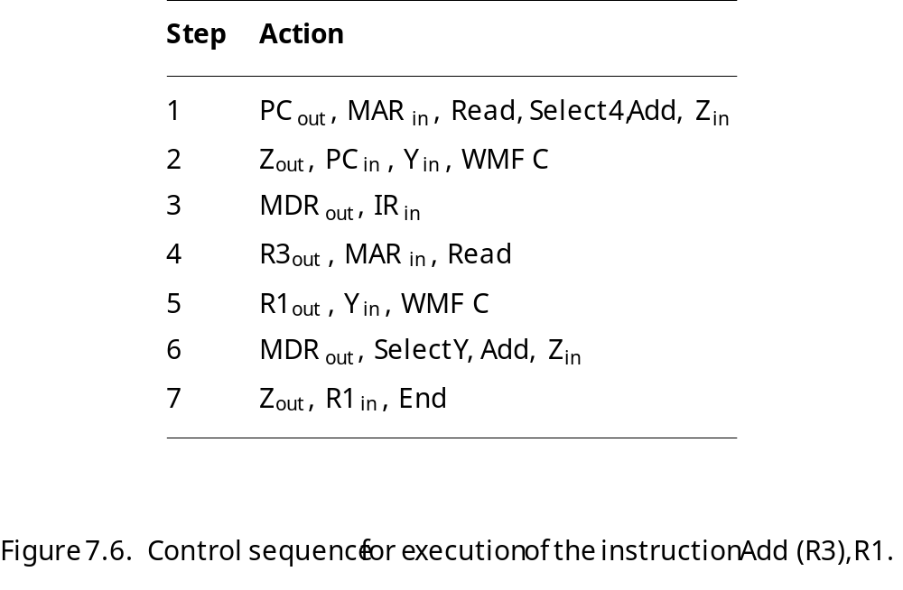
Execution of a Complete Instruction
Central Processing Unit
Add (R3), R1

Slide 39
Execution of Branch Instructions
Central Processing Unit
A branch instruction replaces the contents of PC with the branch target address, which is usually obtained by adding an offset X given in the branch instruction.
The offset X is usually the difference between the branch target address and the address immediately following the branch instruction.
Conditional branch

Slide 40
Execution of Branch Instructions
Central Processing Unit
Step
Action
1
PC
out
,
MAR
in
,
Read,
Select4,
Add,
Z
in
2
Z
out
,
PC
in
,
Y
in
,
WMF
C
3
MDR
out
,
IR
in
4
Offset-field-of-IR
,
Add,
Z
out
in
5
Z
out
,
PC
in
,
End
Figure 7.7. Control sequence for an unconditional branch instruction.

Slide 41
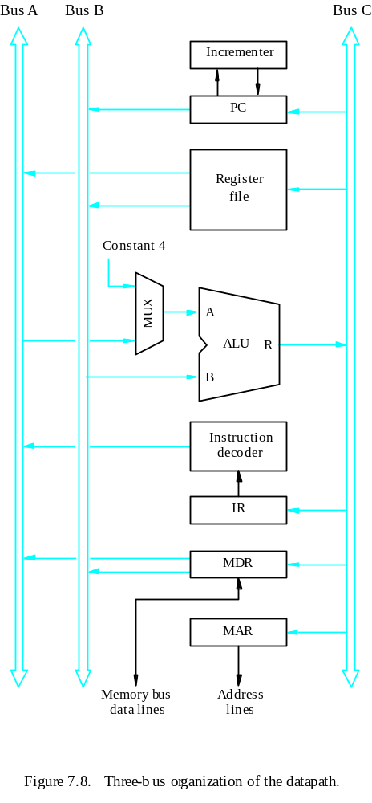
Multiple-Bus Organization
Central Processing Unit

Slide 42
Multiple-Bus Organization
Central Processing Unit
Add R4, R5, R6
Step
Action
1
PC
out
,
R=B,
MAR
in
,
Read,
IncPC
2
WMF
C
3
MDR
outB
,
R=B,
IR
in
4
R4
outA
,
R5
outB
,
SelectA,
Add,
R6
in
,
End
Figure 7.9. Control sequence for the instruction. Add R4,R5,R6,
for the three-bus organization in Figure 7.8.

Slide 43
Quiz
Central Processing Unit
What is the control sequence for execution of the instruction
Add R1, R2
including the instruction fetch phase? (Assume single bus architecture)

Slide 44
Control Unit Organization
Central Processing Unit
Clock
CLK
Control step
counter
External
inputs
Decoder/
IR
encoder
Condition
codes
Control signals
Figure 7.10. Control unit organization.

Slide 45
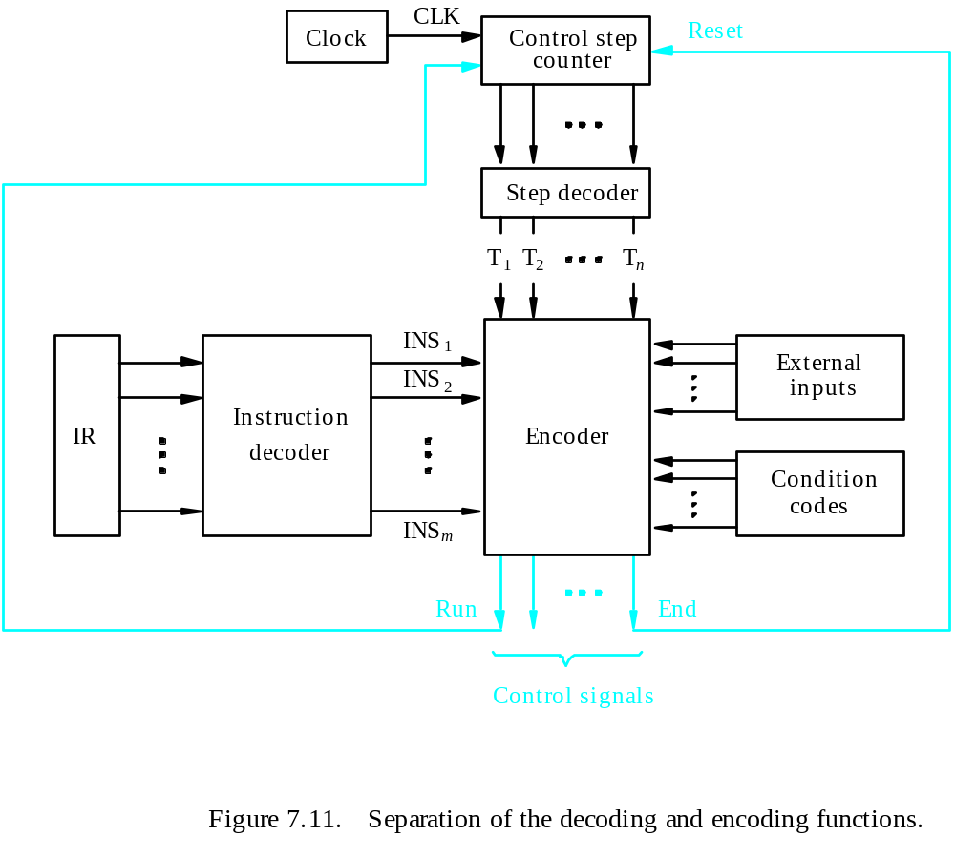
Detailed Block Description
Central Processing Unit

Slide 46
Generating Z_{in}
Central Processing Unit
Z_{in} = T₁ + T₆ • ADD + T₄ • BR + …
Branch
Add
T
4
T
6
T
1
Figure 7.12. Generation of the Z_{in} control signal for the processor in Figure 7.1.

Slide 47
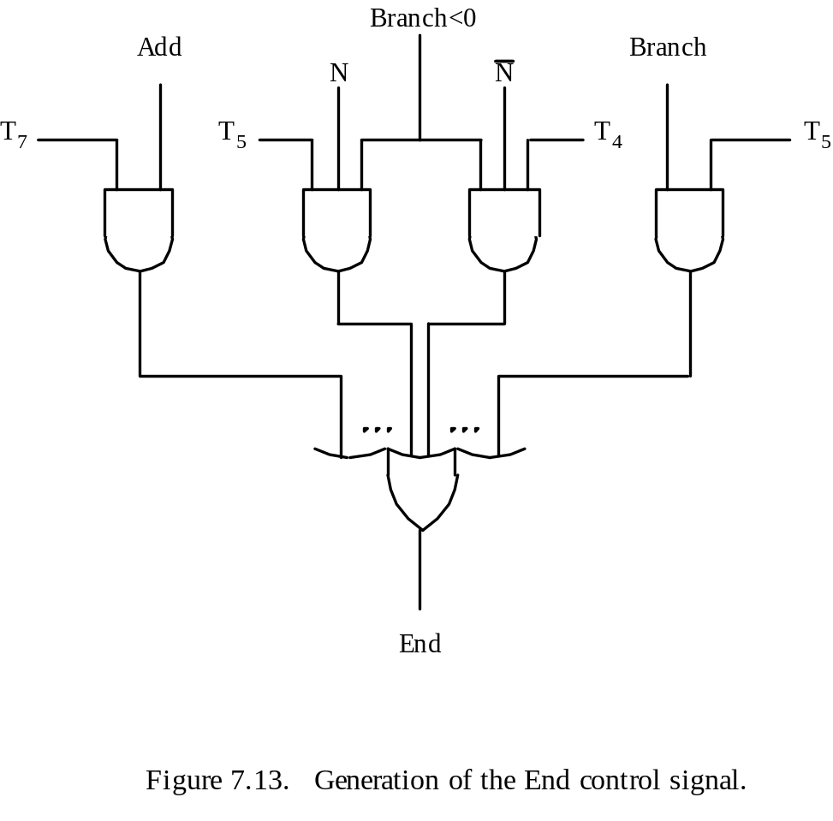
Generating End
Central Processing Unit
End = T₇ • ADD + T₅ • BR + (T₅ • N + T₄ • N) • BRN +…

Slide 48
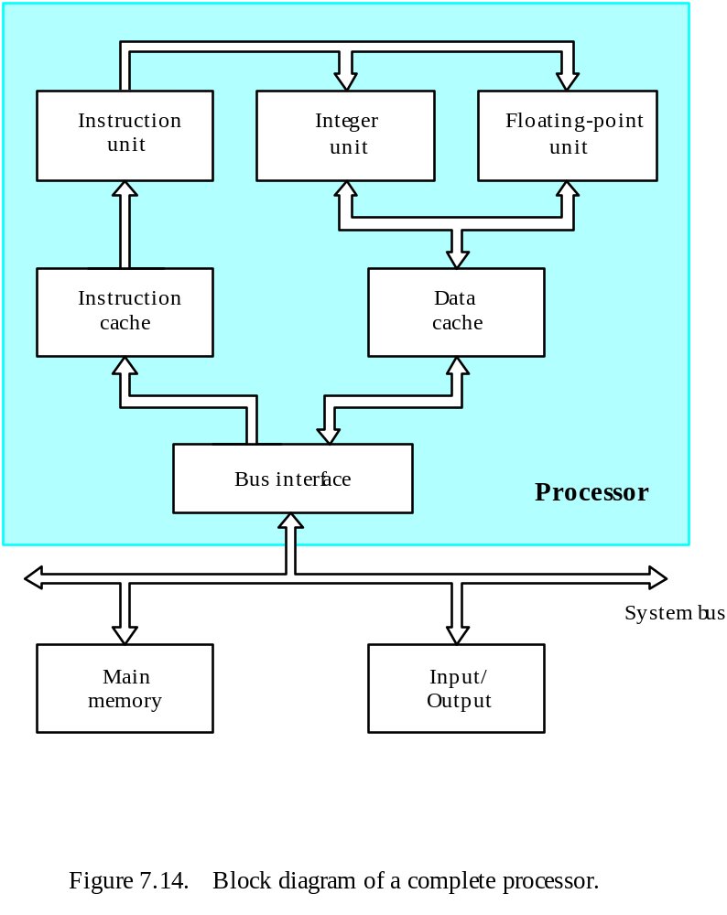
A Complete Processor
Central Processing Unit

Slide 49
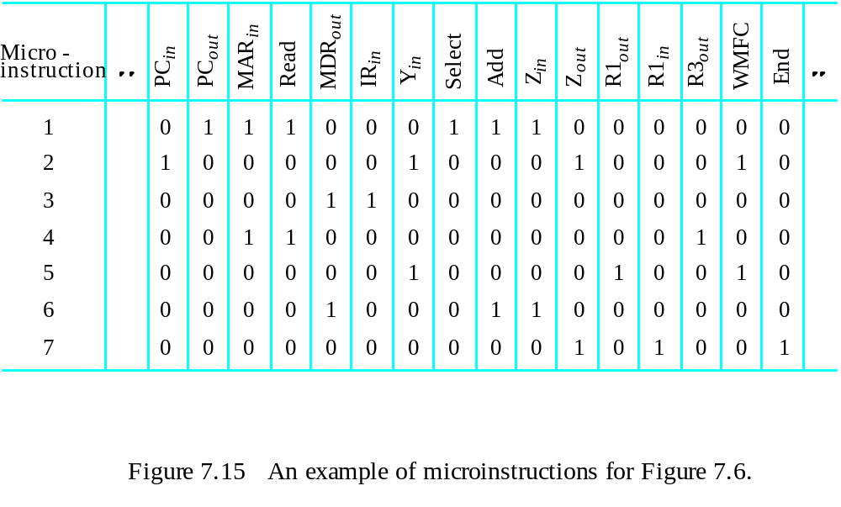
Overview
Microprogrammed Control
Control signals are generated by a program similar to machine language programs.
Control Word (CW); microroutine; microinstruction

Slide 50
Overview
Microprogrammed Control

Slide 51
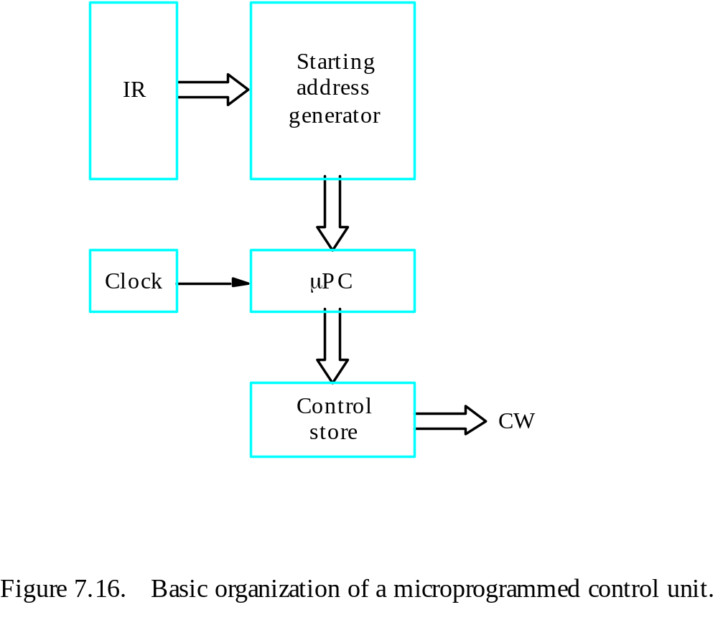
Overview
Microprogrammed Control
Control store
One function
cannot be carried
out by this simple
organization.

Slide 52
Overview
Microprogrammed Control
The previous organization cannot handle the situation when the control unit is required to check the status of the condition codes or external inputs to choose between alternative courses of action.
Use conditional branch microinstruction.
Address
Microinstruction
0
PC
out
,
MAR
in
,
Read,
Select4,
Add,
Z
in
1
Z
out
,
PC
in
,
Y
in
,
WMF
C
2
MDR
out
,
IR
in
3
Branch
to
starting
address
of
appropriate
microroutine
.
.
.
.
.
.
.
.
.
.
.
.
.
.
.
.
.
.
.
.
.
.
.
.
.
.
.
.
.
.
.
.
.
.
.
.
.
.
.
.
.
.
.
.
.
.
.
.
.
.
.
.
.
.
.
.
.
.
.
.
.
.
.
.
.
.
25
If
N=0,
then
branch
to
microinstruction
0
26
Offset-field-of-IR
,
SelectY,
Add,
Z
out
in
27
Z
out
,
PC
in
,
End
Figure 7.17. Microroutine for the instruction Branch<0.

Slide 53
Overview
Microprogrammed Control
External
inputs
Starting and
Condition
IR
branch address
codes
generator
Clock
μ
P
C
Control
CW
store
Figure 7.18. Organization of the control unit to allow
conditional branching in the microprogram.

Slide 54
Microinstructions
Microprogrammed Control
A straightforward way to structure microinstructions is to assign one bit position to each control signal.
However, this is very inefficient.
The length can be reduced: most signals are not needed simultaneously, and many signals are mutually exclusive.
All mutually exclusive signals are placed in the same group in binary coding.

Slide 55
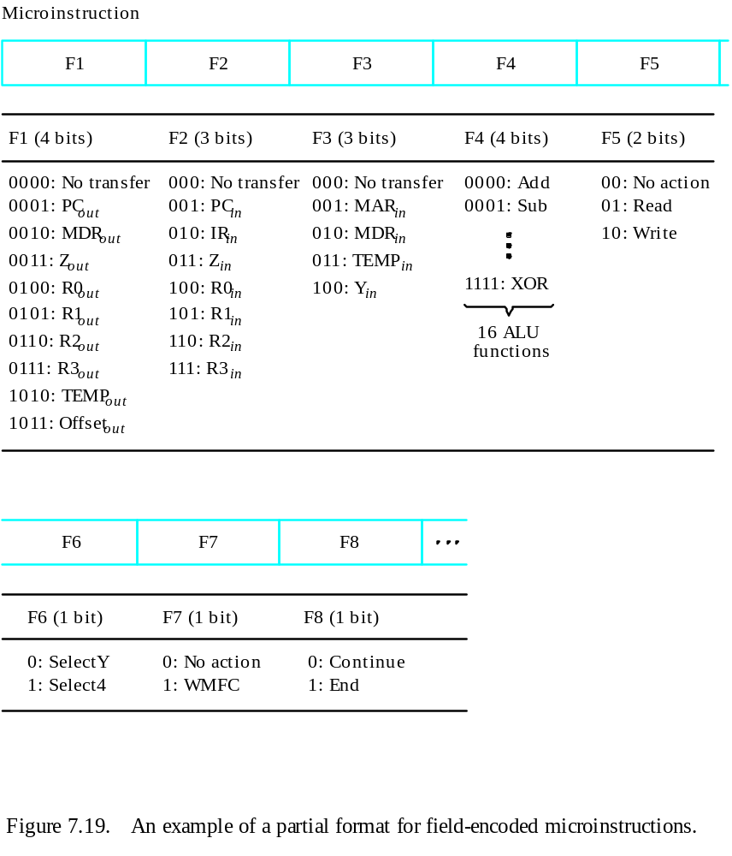
Partial Format for the Microinstructions
Microprogrammed Control
What is the price paid for
this scheme?

Slide 56
Further Improvement
Microprogrammed Control
Enumerate the patterns of required signals in all possible microinstructions. Each meaningful combination of active control signals can then be assigned a distinct code.
Vertical organization
Horizontal organization

Slide 57
Microprogram Sequencing
Microprogrammed Control
If all microprograms require only straightforward sequential execution of microinstructions except for branches, letting a μPC governs the sequencing would be efficient.
However, two disadvantages:
Having a separate microroutine for each machine instruction results in a large total number of microinstructions and a large control store.
Longer execution time because it takes more time to carry out the required branches.
Example: Add src, Rdst
Four addressing modes: register, autoincrement, autodecrement, and indexed (with indirect forms).

Slide 58
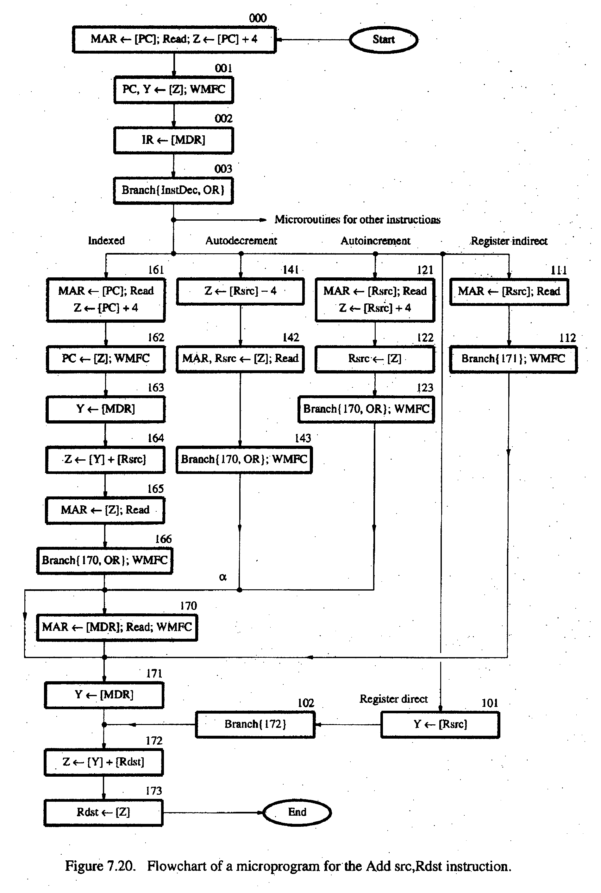
Microprogrammed Control
- Bit-ORing
- Wide-Branch Addressing
- WMFC

Slide 59
Microprogrammed Control
Mode
Contents of IR
OP code
0
1
0
Rsrc
Rdst
11
10
8
7
4
3
0
Address
Microinstruction
(octal)
000
PC
, MAR
, Read, Select
, Add, Z
out
in
4
in
001
Z
out
, PC
in
, Y
in
, WMFC
002
MDR
out
, IR
in
003
μ
Branch {
PC
101 (from Instruction decoder);
μ
←
μ
PC
5,4
←
[IR
10,9
];
μ
PC
←
[IR
10
]
⋅
[IR
9
]
⋅
[IR
8
]}
3
121
Rsrc
, MAR
, Read, Select4, Add, Z
out
in
in
122
Z
out
, Rsrc
in
123
μ
Branch {
μ
PC
←
170;
μ
PC
←
[IR
]}, WMFC
0
8
170
MDR
out
, MAR
in
, Read, WMFC
171
MDR
out
, Y
in
172
Rdst
out
, SelectY
, Add, Z
in
173
Z
out
, Rdst
in
, End
Figure 7.21.
Microinstruction for Add (Rsrc)+,Rdst.
Note:
Microinstruction at location 170 is not executed for this addressing mode.

Slide 60
Microinstructions with Next-Address Field
Microprogrammed Control
The microprogram we discussed requires several branch microinstructions, which perform no useful operation in the datapath.
A powerful alternative approach is to include an address field as a part of every microinstruction to indicate the location of the next microinstruction to be fetched.
Pros: separate branch microinstructions are virtually eliminated; few limitations in assigning addresses to microinstructions.
Cons: additional bits for the address field (around 1/6)

Slide 61
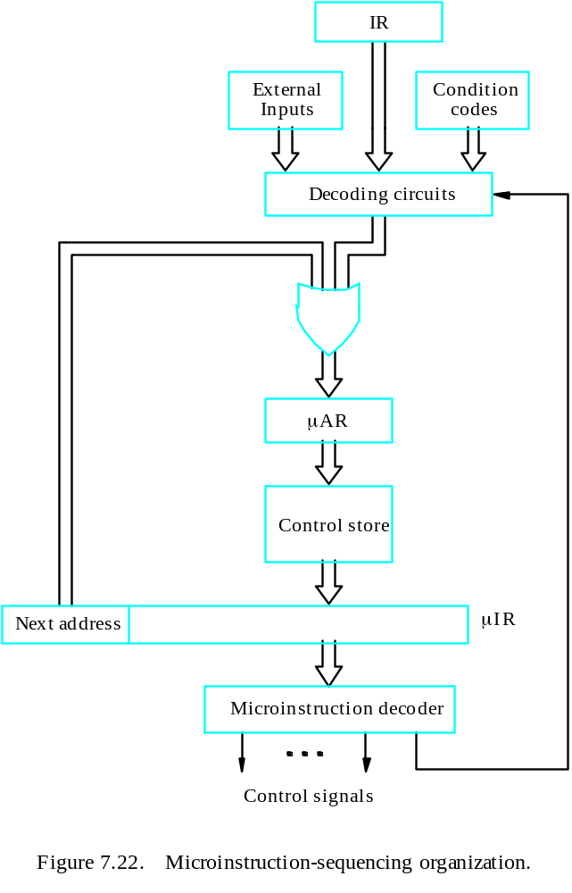
Microinstructions with Next-Address Field
Microprogrammed Control

Slide 62
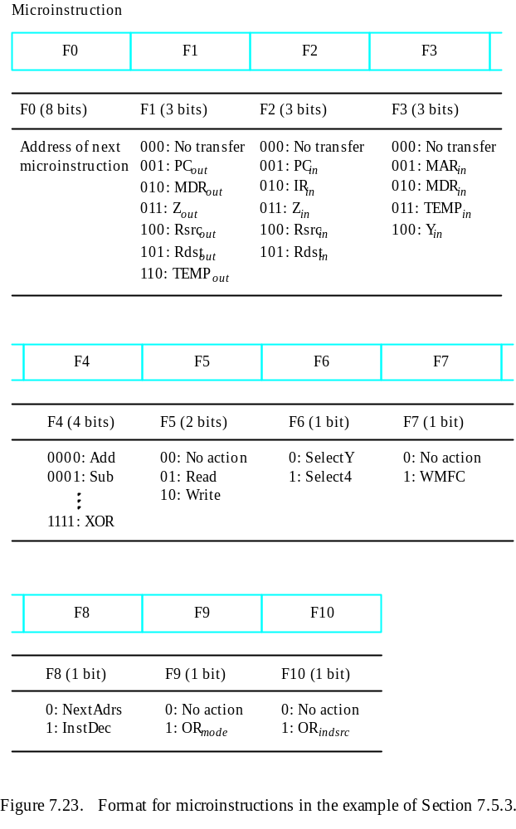
Microprogrammed Control

Slide 63
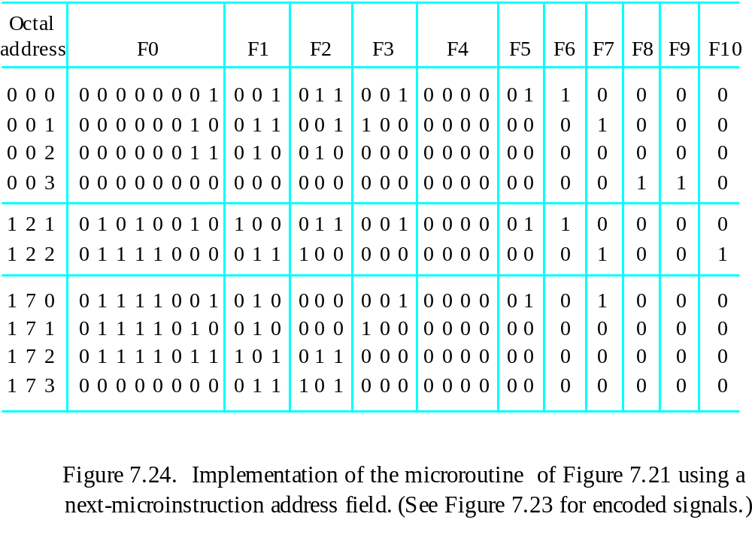
Implementation of the Microroutine
Microprogrammed Control

Slide 64
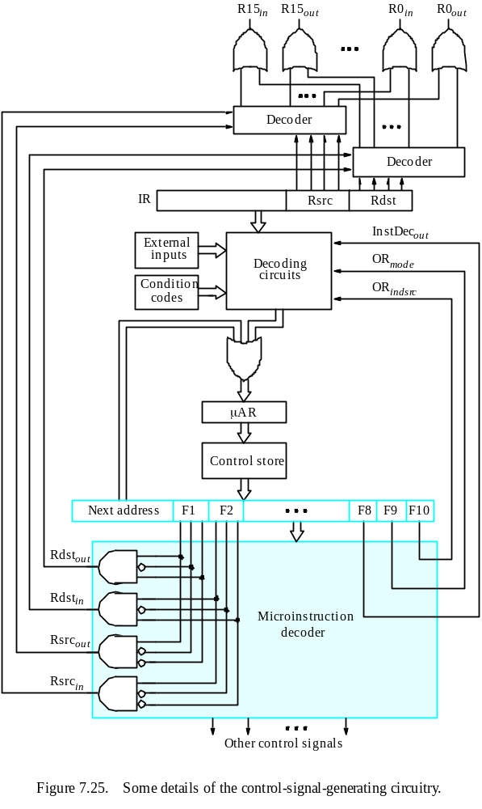
Microprogrammed Control

Slide 65
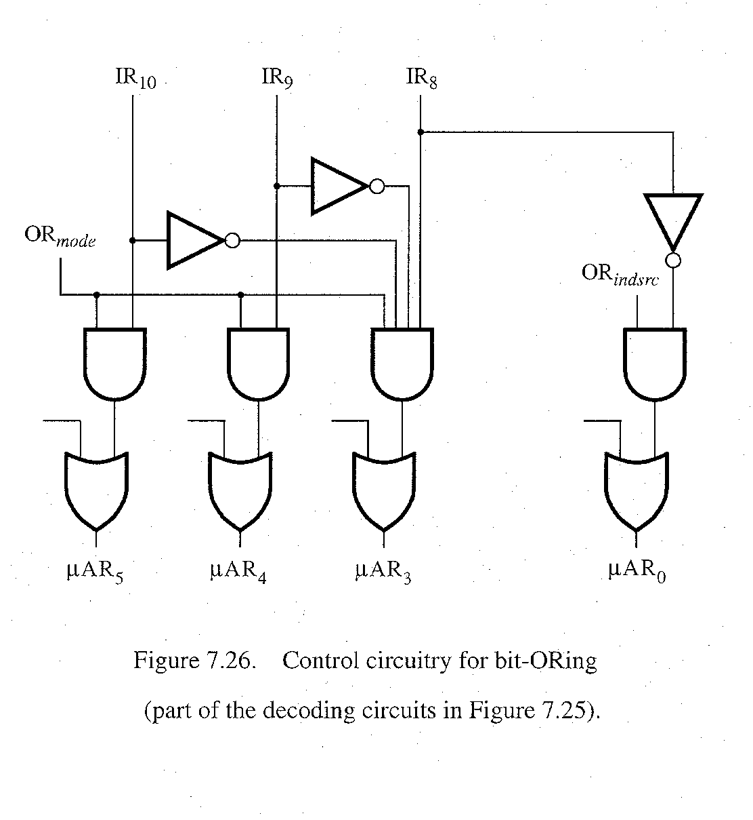
bit-ORing
Microprogrammed Control

Slide 66
PIPELINING AND VECTOR PROCESSING
Pipelining and Vector Processing
Parallel Processing
Pipelining
Arithmetic Pipeline
Instruction Pipeline
RISC Pipeline
Vector Processing
Array Processors

Slide 67
PARALLEL PROCESSING
Pipelining and Vector Processing
Parallel Processing
  Execution of Concurrent Events in the computing
  process to achieve faster Computational Speed
Levels of Parallel Processing
- Job or Program level
- Task or Procedure level
- Inter-Instruction level
- Intra-Instruction level

Slide 68
PARALLEL COMPUTERS
Pipelining and Vector Processing
Parallel Processing
Architectural Classification
  Flynn's classification
    Based on the multiplicity of Instruction Streams and Data Streams
    Instruction Stream
      Sequence of Instructions read from memory
    Data Stream
      Operations performed on the data in the processor
Number of Data Streams
Single
Multiple
Number of
Instruction
Streams
Single
SISD
SIMD
Multiple
MISD
MIMD

Slide 69
COMPUTER ARCHITECTURES FOR PARALLEL PROCESSING
Pipelining and Vector Processing
Parallel Processing
Von-Neuman
based
Dataflow
Reduction
SISD
MISD
SIMD
MIMD
Superscalar processors
Superpipelined processors
VLIW
Nonexistence
Array processors
Systolic arrays
Associative processors
Shared-memory multiprocessors
Bus based
Crossbar switch based
Multistage IN based
Message-passing multicomputers
Hypercube
Mesh
Reconfigurable

Slide 70
SISD COMPUTER SYSTEMS
Pipelining and Vector Processing
Parallel Processing
Control
Unit
Processor
Unit
Data stream
Memory
Instruction stream
Characteristics
- Standard von Neumann machine
- Instructions and data are stored in memory
- One operation at a time
Limitations
Von Neumann bottleneck
Maximum speed of the system is limited by the
Memory Bandwidth (bits/sec or bytes/sec)
- Limitation on Memory Bandwidth
- Memory is shared by CPU and I/O

Slide 71
SISD PERFORMANCE IMPROVEMENTS
Pipelining and Vector Processing
Parallel Processing
Multiprogramming
Spooling
Multifunction processor
Pipelining
Exploiting instruction-level parallelism
- Superscalar
- Superpipelining
- VLIW (Very Long Instruction Word)

Slide 72
MISD COMPUTER SYSTEMS
Pipelining and Vector Processing
Parallel Processing
M
CU
P
M
CU
P
Memory
•
•
•
•
•
•
M
CU
P
Data stream
Instruction stream
Characteristics
- There is no computer at present that can be
classified as MISD

Slide 73
SIMD COMPUTER SYSTEMS
Pipelining and Vector Processing
Parallel Processing
Memory
Data bus
Control Unit
Instruction stream
P
P
• • •
P
Processor units
Data stream
Alignment network
M
M
• • •
M
Memory modules
Characteristics
- Only one copy of the program exists
- A single controller executes one instruction at a time

Slide 74
TYPES OF SIMD COMPUTERS
Pipelining and Vector Processing
Parallel Processing
Array Processors
- The control unit broadcasts instructions to all PEs,
and all active PEs execute the same instructions
- ILLIAC IV, GF-11, Connection Machine, DAP, MPP
Systolic Arrays
- Regular arrangement of a large number of
very simple processors constructed on
VLSI circuits
- CMU Warp, Purdue CHiP
Associative Processors
- Content addressing
- Data transformation operations over many sets
of arguments with a single instruction
- STARAN, PEPE

Slide 75
MIMD COMPUTER SYSTEMS
Pipelining and Vector Processing
Parallel Processing
P
M
P
M
• • •
P
M
Interconnection Network
Shared Memory
Characteristics
- Multiple processing units
- Execution of multiple instructions on multiple data
Types of MIMD computer systems
- Shared memory multiprocessors
- Message-passing multicomputers

Slide 76
SHARED MEMORY MULTIPROCESSORS
Pipelining and Vector Processing
Parallel Processing
M
M
• • •
M
Buses,
Multistage IN,
Crossbar Switch
Interconnection Network(IN)
P
P
• • •
P
Characteristics
All processors have equally direct access to
one large memory address space
Example systems
Bus and cache-based systems
- Sequent Balance, Encore Multimax
Multistage IN-based systems
- Ultracomputer, Butterfly, RP3, HEP
Crossbar switch-based systems
- C.mmp, Alliant FX/8
Limitations
Memory access latency
Hot spot problem

Slide 77
MESSAGE-PASSING MULTICOMPUTER
Pipelining and Vector Processing
Parallel Processing
Message-Passing Network
Point-to-point connections
P
P
• • •
P
M
M
• • •
M
Characteristics
- Interconnected computers
- Each processor has its own memory, and
communicate via message-passing
Example systems
- Tree structure: Teradata, DADO
- Mesh-connected: Rediflow, Series 2010, J-Machine
- Hypercube: Cosmic Cube, iPSC, NCUBE, FPS T Series, Mark III
Limitations
- Communication overhead
- Hard to programming

Slide 78
PIPELINING
Pipelining and Vector Processing
Pipelining
  A technique of decomposing a sequential process
  into suboperations, with each subprocess being
  executed in a partial dedicated segment that
  operates concurrently with all other segments.
A_{i} * B_{i} + C_{i} for i = 1, 2, 3, ... , 7
A_{i}
B_{i}
Memory
C_{i}
Segment 1
R1
R2
Multiplier
Segment 2
R3
R4
Segment 3
Adder
R5
R1 ← A_{i}, R2 ← B_{i} Load A_{i} and B_{i}
R3 ← R1 * R2, R4 ← C_{i} Multiply and load C_{i}
R5 ← R3 + R4 Add

Slide 79
OPERATIONS IN EACH PIPELINE STAGE
Pipelining and Vector Processing
Pipelining
Clock
Pulse
Segment 1
Segment 2
Segment 3
  Number R1 R2 R3 R4 R5
  1 A1 B1
  2 A2 B2 A1 * B1 C1
  3 A3 B3 A2 * B2 C2 A1 * B1 + C1
  4 A4 B4 A3 * B3 C3 A2 * B2 + C2
  5 A5 B5 A4 * B4 C4 A3 * B3 + C3
  6 A6 B6 A5 * B5 C5 A4 * B4 + C4
  7 A7 B7 A6 * B6 C6 A5 * B5 + C5
  8 A7 * B7 C7 A6 * B6 + C6
  9 A7 * B7 + C7

Slide 80
GENERAL PIPELINE
Pipelining and Vector Processing
Pipelining
General Structure of a 4-Segment Pipeline
Clock
Input
S
R
S
R
S
R
S
R
1
1
2
2
3
3
4
4
Space-Time Diagram
1
2
3
4
5
6
7
8
9
Clock cycles
Segment
1
T1
T2
T3
T4
T5
T6
2
T1
T2
T3
T4
T5
T6
3
T1
T2
T3
T4
T5
T6
4
T1
T2
T3
T4
T5
T6

Slide 81
PIPELINE SPEEDUP
Pipelining and Vector Processing
Pipelining
  n: Number of tasks to be performed
Conventional Machine (Non-Pipelined)
  t_{n}: Clock cycle
  τ₁: Time required to complete the n tasks
  τ₁ = n * t_{n}
Pipelined Machine (k stages)
  t_{p}: Clock cycle (time to complete each suboperation)
  τ_{κ}: Time required to complete the n tasks
  τ_{κ} = (k + n - 1) * t_{p}
Speedup
  S_{k}: Speedup
S_{k} = n*t_{n} / (k + n - 1)*t_{p}
t_{n}
lim
S_{k} =
t_{p}
( = k, if t_{n} = k * t_{p} )
n → ∞

Slide 82
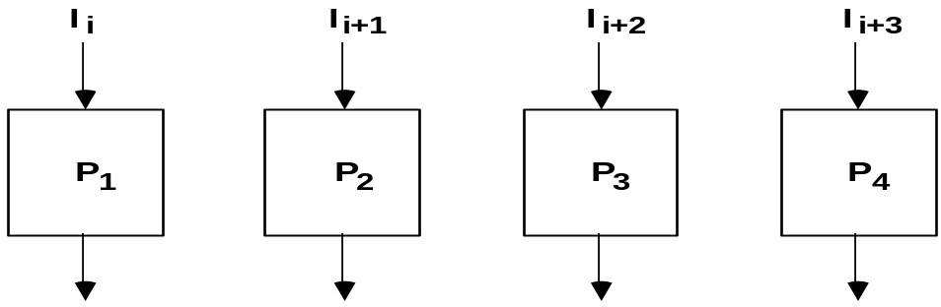
PIPELINE AND MULTIPLE FUNCTION UNITS
Pipelining and Vector Processing
Pipelining
Example
- 4-stage pipeline
- subopertion in each stage; t_{p} = 20nS
- 100 tasks to be executed
- 1 task in non-pipelined system; 20*4 = 80nS
Pipelined System
(k + n - 1)*t_{p} = (4 + 99) * 20 = 2060nS
Non-Pipelined System
n*k*t_{p} = 100 * 80 = 8000nS
Speedup
S_{k} = 8000 / 2060 = 3.88
4-Stage Pipeline is basically identical to the system
with 4 identical function units
Multiple Functional Units

Slide 83
ARITHMETIC PIPELINE
Pipelining and Vector Processing
Arithmetic Pipeline
Floating-point adder
Exponents
Mantissas
a
b
A
B
X = A x 2ª
Y = B x 2^{b}
R
R
[1] Compare the exponents
[2] Align the mantissa
[3] Add/sub the mantissa
[4] Normalize the result
Segment 1:
Compare
Difference
exponents
by subtraction
R
Segment 2:
Choose exponent
Align mantissa
R
Segment 3:
Add or subtract
mantissas
R
R
Segment 4:
Adjust
Normalize
exponent
result
R
R

Slide 84
4-STAGE FLOATING POINT ADDER
Pipelining and Vector Processing
Arithmetic Pipeline
p
q
A = a x 2
B = b x 2
p
a
q
b
Stages:
Exponent
Other
Fraction
S1
subtractor
fraction
selector
r = max(p,q)
Fraction with min(p,q)
t = |p - q|
Right shifter
S2
Fraction
adder
r
c
Leading zero
S3
counter
c
Left shifter
r
d
Exponent
S4
adder
s
d
r
s
C = A + B = c x 2 = d x 2
(r = max (p,q), 0.5 ≤ d < 1)

Slide 85
INSTRUCTION CYCLE
Pipelining and Vector Processing
Instruction Pipeline
Six Phases* in an Instruction Cycle
[1] Fetch an instruction from memory
[2] Decode the instruction
[3] Calculate the effective address of the operand
[4] Fetch the operands from memory
[5] Execute the operation
[6] Store the result in the proper place
* Some instructions skip some phases
* Effective address calculation can be done in
the part of the decoding phase
* Storage of the operation result into a register
is done automatically in the execution phase
==> 4-Stage Pipeline
[1] FI: Fetch an instruction from memory
[2] DA: Decode the instruction and calculate
the effective address of the operand
[3] FO: Fetch the operand
[4] EX: Execute the operation

Slide 86
INSTRUCTION PIPELINE
Pipelining and Vector Processing
Instruction Pipeline
Execution of Three Instructions in a 4-Stage Pipeline
Conventional
i
FI
DA
FO
EX
i+1
FI
DA
FO
EX
i+2
FI
DA
FO
EX
Pipelined
i
FI
DA
FO
EX
i+1
FI
DA
FO
EX
i+2
FI
DA
FO
EX

Slide 87
INSTRUCTION EXECUTION IN A 4-STAGE PIPELINE
Pipelining and Vector Processing
Instruction Pipeline
Segment1:
Fetch instruction
from memory
Decode instruction
Segment2:
and calculate
effective address
yes
Branch?
no
Segment3:
Fetch operand
from memory
Segment4:
Execute instruction
Interrupt
yes
Interrupt?
handling
no
Update PC
Empty pipe
Step:
1
2
3
4
5
6
7
8
9
10
11
12
13
Instruction
1
FI
DA
FO
EX
2
FI
DA
FO
EX
(Branch)
3
FI
DA
FO
EX
4
FI
FI
DA
FO
EX
5
FI
DA
FO
EX
6
FI
DA
FO
EX
7
FI
DA
FO
EX

Slide 88
MAJOR HAZARDS IN PIPELINED EXECUTION
Pipelining and Vector Processing
Instruction Pipeline
  Structural hazards(Resource Conflicts)
  Hardware Resources required by the instructions in
  simultaneous overlapped execution cannot be met
  Data hazards (Data Dependency Conflicts)
  An instruction scheduled to be executed in the pipeline requires the
  result of a previous instruction, which is not yet available
  R1 <- B + C
  R1 <- R1 + 1
ADD
DA
B,C
+
Data dependency
INC
DA
bubble
R1
+1
  Control hazards
  Branches and other instructions that change the PC
  make the fetch of the next instruction to be delayed
JMP
ID
PC
+
PC
Branch address dependency
bubble
IF
ID
OF
OE
OS
Hazards in pipelines may make it
necessary to stall the pipeline
Pipeline Interlock:
Detect Hazards Stall until it is cleared

Slide 89
STRUCTURAL HAZARDS
Pipelining and Vector Processing
Instruction Pipeline
Structural Hazards
Occur when some resource has not been
duplicated enough to allow all combinations
of instructions in the pipeline to execute
Example: With one memory-port, a data and an instruction fetch
cannot be initiated in the same clock
i
FI
DA
FO
EX
i+1
FI
DA
FO
EX
i+2
stall
stall
FI
DA
FO
EX
The Pipeline is stalled for a structural hazard
<- Two Loads with one port memory
-> Two-port memory will serve without stall

Slide 90
DATA HAZARDS
Pipelining and Vector Processing
Instruction Pipeline
Data Hazards
Occurs when the execution of an instruction
depends on the results of a previous instruction
ADD R1, R2, R3
SUB R4, R1, R5
Data hazard can be dealt with either hardware
techniques or software technique
Hardware Technique
Interlock
- hardware detects the data dependencies and delays the scheduling
of the dependent instruction by stalling enough clock cycles
Forwarding (bypassing, short-circuiting)
- Accomplished by a data path that routes a value from a source
(usually an ALU) to a user, bypassing a designated register. This
allows the value to be produced to be used at an earlier stage in the
pipeline than would otherwise be possible
Software Technique
Instruction Scheduling(compiler) for delayed load

Slide 91
FORWARDING HARDWARE
Pipelining and Vector Processing
Instruction Pipeline
Example:
ADD R1, R2, R3
SUB R4, R1, R5
3-stage Pipeline
I: Instruction Fetch
A: Decode, Read Registers,
ALU Operations
E: Write the result to the destination register
Register
file
MUX
MUX
Bypass
path
Result
write bus
ALU
R4
ALU result buffer
ADD
I
A
E
SUB
I
A
E
Without Bypassing
SUB
I
A
E
With Bypassing

Slide 92
INSTRUCTION SCHEDULING
Pipelining and Vector Processing
Instruction Pipeline
a = b + c;
d = e - f;
Unscheduled code:
Scheduled Code:
LW Rb, b
LW Rc, c
ADD Ra, Rb, Rc
SW a, Ra
LW Re, e
LW Rf, f
SUB Rd, Re, Rf
SW d, Rd
LW Rb, b
LW Rc, c
LW Re, e
ADD Ra, Rb, Rc
LW Rf, f
SW a, Ra
SUB Rd, Re, Rf
SW d, Rd
Delayed Load
A load requiring that the following instruction not use its result

Slide 93
CONTROL HAZARDS
Pipelining and Vector Processing
Instruction Pipeline
Branch Instructions
- Branch target address is not known until
the branch instruction is completed
- Stall -> waste of cycle times
Branch
Instruction
FI DA FO EX
Next
Instruction
FI DA FO EX
Target address available
Dealing with Control Hazards
* Prefetch Target Instruction
* Branch Target Buffer
* Loop Buffer
* Branch Prediction
* Delayed Branch

Slide 94
CONTROL HAZARDS
Pipelining and Vector Processing
Instruction Pipeline
Prefetch Target Instruction
  Fetch instructions in both streams, branch not taken and branch taken
  Both are saved until branch branch is executed. Then, select the right
  instruction stream and discard the wrong stream
Branch Target Buffer(BTB; Associative Memory)
  Entry: Addr of previously executed branches; Target instruction
  and the next few instructions
  When fetching an instruction, search BTB.
  If found, fetch the instruction stream in BTB;
  If not, new stream is fetched and update BTB
Loop Buffer(High Speed Register file)
  Storage of entire loop that allows to execute a loop without accessing memory
Branch Prediction
  Guessing the branch condition, and fetch an instruction stream based on
  the guess. Correct guess eliminates the branch penalty
Delayed Branch
  Compiler detects the branch and rearranges the instruction sequence
  by inserting useful instructions that keep the pipeline busy
  in the presence of a branch instruction

Slide 95
RISC PIPELINE
Pipelining and Vector Processing
RISC Pipeline
RISC
- Machine with a very fast clock cycle that
executes at the rate of one instruction per cycle
<- Simple Instruction Set
Fixed Length Instruction Format
Register-to-Register Operations
Instruction Cycles of Three-Stage Instruction Pipeline
Data Manipulation Instructions
I: Instruction Fetch
A: Decode, Read Registers, ALU Operations
E: Write a Register
Load and Store Instructions
I: Instruction Fetch
A: Decode, Evaluate Effective Address
E: Register-to-Memory or Memory-to-Register
Program Control Instructions
I: Instruction Fetch
A: Decode, Evaluate Branch Address
E: Write Register(PC)

Slide 96
DELAYED LOAD
Pipelining and Vector Processing
RISC Pipeline
  LOAD: R1 ← M[address 1]
  LOAD: R2 ← M[address 2]
  ADD: R3 ← R1 + R2
  STORE: M[address 3] ← R3
Three-segment pipeline timing
Pipeline timing with data conflict
clock cycle 1 2 3 4 5 6
Load R1 I A E
Load R2 I A E
Add R1+R2 I A E
Store R3 I A E
Pipeline timing with delayed load
clock cycle 1 2 3 4 5 6 7
Load R1 I A E
Load R2 I A E
NOP I A E
Add R1+R2 I A E
Store R3 I A E
The data dependency is taken
care by the compiler rather
than the hardware

Slide 97
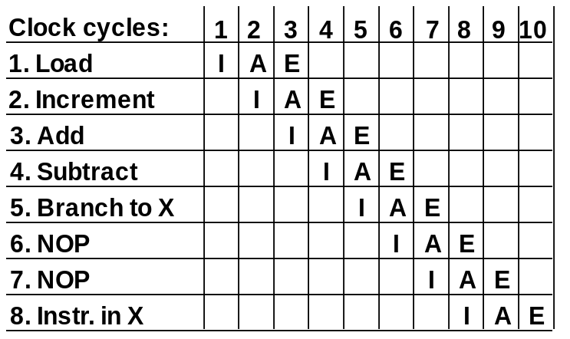
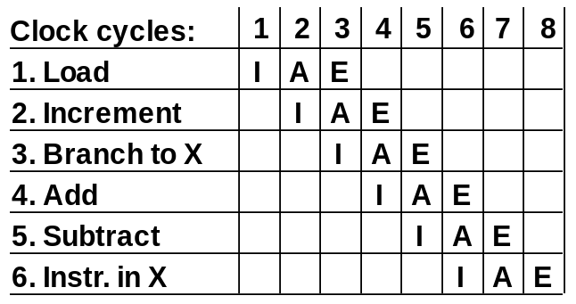
DELAYED BRANCH
Pipelining and Vector Processing
RISC Pipeline
Compiler analyzes the instructions before and after
the branch and rearranges the program sequence by
inserting useful instructions in the delay steps
Using no-operation instructions
Rearranging the instructions

Slide 98
VECTOR PROCESSING
Pipelining and Vector Processing
Vector Processing
Vector Processing Applications
Problems that can be efficiently formulated in terms of vectors
  Long-range weather forecasting
  Petroleum explorations
  Seismic data analysis
  Medical diagnosis
  Aerodynamics and space flight simulations
  Artificial intelligence and expert systems
  Mapping the human genome
  Image processing
Vector Processor (computer)
Ability to process vectors, and related data structures such as matrices
and multi-dimensional arrays, much faster than conventional computers
Vector Processors may also be pipelined

Slide 99
VECTOR PROGRAMMING
Pipelining and Vector Processing
Vector Processing
DO 20 I = 1, 100
20 C(I) = B(I) + A(I)
Conventional computer
Initialize I = 0
20 Read A(I)
Read B(I)
Store C(I) = A(I) + B(I)
Increment I = i + 1
If I ≤ 100 goto 20
Vector computer
C(1:100) = A(1:100) + B(1:100)

Slide 100
VECTOR INSTRUCTIONS
Pipelining and Vector Processing
Vector Processing
f1: V ∗ V
f2: V ∗ S
f3: V x V ∗ V
f4: V x S ∗ V
V: Vector operand
S: Scalar operand
Type Mnemonic Description (I = 1, ..., n)
  f1 VSQR Vector square root B(I) ∗ SQR(A(I))
  VSIN Vector sine B(I) ∗ sin(A(I))
  VCOM Vector complement A(I) ∗ A(I)
  f2 VSUM Vector summation S ∗ Σ A(I)
  VMAX Vector maximum S ∗ max{A(I)}
  f3 VADD Vector add C(I) ∗ A(I) + B(I)
  VMPY Vector multiply C(I) ∗ A(I) * B(I)
  VAND Vector AND C(I) ∗ A(I) . B(I)
  VLAR Vector larger C(I) ∗ max(A(I),B(I))
  VTGE Vector test > C(I) ∗ 0 if A(I) < B(I)
  C(I) ∗ 1 if A(I) > B(I)
  f4 SADD Vector-scalar add B(I) ∗ S + A(I)
  SDIV Vector-scalar divide B(I) ∗ A(I) / S

Slide 101
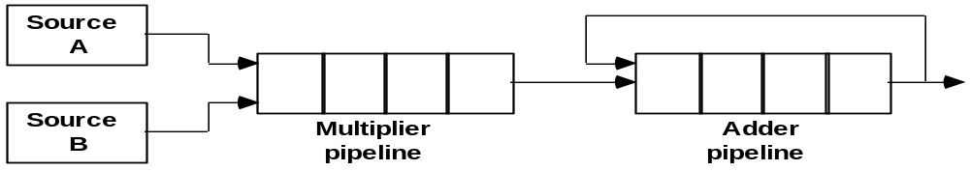
VECTOR INSTRUCTION FORMAT
Pipelining and Vector Processing
Vector Processing
Vector Instruction Format
Pipeline for Inner Product

Slide 102
MULTIPLE MEMORY MODULE AND INTERLEAVING
Pipelining and Vector Processing
Vector Processing
Multiple Module Memory
Address bus
M0 M1 M2 M3
AR
AR
AR
AR
Memory
Memory
Memory
Memory
array
array
array
array
DR
DR
DR
DR
Data bus
Address Interleaving
Different sets of addresses are assigned to
different memory modules

Slide 103
MULTIPROCESSORS
Multiprocessors
  Characteristics of Multiprocessors
  Interconnection Structures
  Interprocessor Arbitration
  Interprocessor Communication
  and Synchronization
  Cache Coherence

Slide 104
TERMINOLOGY
Multiprocessors
Characteristics of Multiprocessors
Parallel Computing
Simultaneous use of multiple processors, all components
of a single architecture, to solve a task. Typically processors identical,
single user (even if machine multiuser)
Distributed Computing
Use of a network of processors, each capable of being
viewed as a computer in its own right, to solve a problem. Processors
may be heterogeneous, multiuser, usually individual task is assigned
to a single processors
Concurrent Computing
All of the above?

Slide 105
TERMINOLOGY
Multiprocessors
Characteristics of Multiprocessors
Supercomputing
Use of fastest, biggest machines to solve big, computationally
intensive problems. Historically machines were vector computers,
but parallel/vector or parallel becoming the norm
Pipelining
Breaking a task into steps performed by different units, and multiple
inputs stream through the units, with next input starting in a unit when
previous input done with the unit but not necessarily done with the task
Vector Computing
Use of vector processors, where operation such as multiply
broken into several steps, and is applied to a stream of operands
(“vectors”). Most common special case of pipelining
Systolic
Similar to pipelining, but units are not necessarily arranged linearly,
steps are typically small and more numerous, performed in lockstep
fashion. Often used in special-purpose hardware such as image or signal
processors

Slide 106
SPEEDUP AND EFFICIENCY
Multiprocessors
Characteristics of Multiprocessors
A: Given problem
T*(n): Time of best sequential algorithm to solve an
instance of A of size n on 1 processor
T_{p}(n): Time needed by a given parallel algorithm
and given parallel architecture to solve an
instance of A of size n, using p processors
Note: T*(n) ≤ T₁(n)
Speedup: T*(n) / T_{p}(n)
Efficiency: T*(n) / [pT_{p}(n)]
Speedup should be between 0 and p, and
Efficiency should be between 0 and 1
Speedup is linear if there is a constant c > 0
so that speedup is always at least cp.
Speedup
Perfect Speedup
1 2 3 4 5 6 7 8 9 10
Processors

Slide 107
AMDAHL’S LAW
Multiprocessors
Characteristics of Multiprocessors
Given a program
f : Fraction of time that represents operations
that must be performed serially
Maximum Possible Speedup: S
1
S ≤ , with p processors
f + (1 - f ) / p
S < 1 / f , with unlimited number of processors
- Ignores possibility of new algorithm, with much smaller f
- Ignores possibility that more of program is run from higher speed
memory such as Registers, Cache, Main Memory
- Often problem is scaled with number of processors, and f is a
function of size which may be decreasing (Serial code may take
constant amount of time, independent of size)

Slide 108
FLYNN’s HARDWARE TAXONOMY
Multiprocessors
Characteristics of Multiprocessors
I: Instruction Stream
D: Data Stream
M
[
M
S S
] I [ ] D
SI: Single Instruction Stream
- All processors are executing the same instruction in the same cycle
- Instruction may be conditional
- For Multiple processors, the control processor issues an instruction
MI: Multiple Instruction Stream
- Different processors may be simultaneously
executing different instructions
SD: Single Data Stream
- All of the processors are operating on the same
data items at any given time
MD: Multiple Data Stream
- Different processors may be simultaneously
operating on different data items
SISD : standard serial computer
MISD : very rare
MIMD and SIMD : Parallel processing computers

Slide 109
COUPLING OF PROCESSORS
Multiprocessors
Characteristics of Multiprocessors
Tightly Coupled System
- Tasks and/or processors communicate in a highly synchronized fashion
- Communicates through a common shared memory
- Shared memory system
Loosely Coupled System
- Tasks or processors do not communicate in a
synchronized fashion
- Communicates by message passing packets
- Overhead for data exchange is high
- Distributed memory system

Slide 110
GRANULARITY OF PARALLELISM
Multiprocessors
Characteristics of Multiprocessors
Granularity of Parallelism
  Coarse-grain
  - A task is broken into a handful of pieces, each
  of which is executed by a powerful processor
  - Processors may be heterogeneous
  - Computation/communication ratio is very high
  Medium-grain
  - Tens to few thousands of pieces
  - Processors typically run the same code
  - Computation/communication ratio is often hundreds or more
  Fine-grain
  - Thousands to perhaps millions of small pieces, executed by very
  small, simple processors or through pipelines
  - Processors typically have instructions broadcasted to them
  - Compute/communicate ratio often near unity

Slide 111
MEMORY
Multiprocessors
Characteristics of Multiprocessors
  Shared (Global) Memory
  - A Global Memory Space accessible by all processors
  - Processors may also have some local memory
  Distributed (Local, Message-Passing) Memory
  - All memory units are associated with processors
  - To retrieve information from another processor's
  memory a message must be sent there
  Uniform Memory
  - All processors take the same time to reach all memory locations
  Nonuniform (NUMA) Memory
  - Memory access is not uniform
SHARED MEMORY
Memory
DISTRIBUTED MEMORY
Network
Network
Processors
Processors/Memory

Slide 112
SHARED MEMORY MULTIPROCESSORS
Multiprocessors
Characteristics of Multiprocessors
M
M
. . .
M
Buses,
Multistage IN,
Crossbar Switch
Interconnection Network
P
P
. . .
P
Characteristics
All processors have equally direct access to one
large memory address space
Example systems
- Bus and cache-based systems: Sequent Balance, Encore Multimax
- Multistage IN-based systems: Ultracomputer, Butterfly, RP3, HEP
- Crossbar switch-based systems: C.mmp, Alliant FX/8
Limitations
Memory access latency; Hot spot problem

Slide 113
MESSAGE-PASSING MULTIPROCESSORS
Multiprocessors
Characteristics of Multiprocessors
Message-Passing Network
Point-to-point connections
P
P
. . .
P
M
M
. . .
M
Characteristics
- Interconnected computers
- Each processor has its own memory, and
communicate via message-passing
Example systems
- Tree structure: Teradata, DADO
- Mesh-connected: Rediflow, Series 2010, J-Machine
- Hypercube: Cosmic Cube, iPSC, NCUBE, FPS T Series, Mark III
Limitations
- Communication overhead; Hard to programming

Slide 114
INTERCONNECTION STRUCTURES
Multiprocessors
Interconnection Structure
* Time-Shared Common Bus
* Multiport Memory
* Crossbar Switch
* Multistage Switching Network
* Hypercube System
Bus
All processors (and memory) are connected to a
common bus or busses
- Memory access is fairly uniform, but not very scalable

Slide 115
BUS
Multiprocessors
Interconnection Structure
- A collection of signal lines that carry module-to-module communication
- Data highways connecting several digital system elements
Operations of Bus
Devices
M3
S7
M6
S5
M4
S2
Bus
  M3 wishes to communicate with S5
  [1] M3 sends signals (address) on the bus that causes
  S5 to respond
  [2] M3 sends data to S5 or S5 sends data to
  M3(determined by the command line)
  Master Device: Device that initiates and controls the communication
  Slave Device: Responding device
  Multiple-master buses
  -> Bus conflict
  -> need bus arbitration

Slide 116
SYSTEM BUS STRUCTURE FOR MULTIPROCESSORS
Multiprocessors
Interconnection Structure
Local Bus
Common
Shared
Memory
System
Bus
Controller
Local
Memory
CPU
IOP
SYSTEM BUS
System
Bus
Controller
Local
Memory
System
Bus
Controller
Local
Memory
CPU
IOP
CPU
Local Bus
Local Bus

Slide 117
MULTIPORT MEMORY
Multiprocessors
Interconnection Structure
Multiport Memory Module
- Each port serves a CPU
Memory Module Control Logic
- Each memory module has control logic
- Resolve memory module conflicts Fixed priority among CPUs
Advantages
- Multiple paths -> high transfer rate
Disadvantages
- Memory control logic
- Large number of cables and
connections
Memory Modules
MM 1
MM 2
MM 3
MM 4
CPU 1
CPU 2
CPU 3
CPU 4

Slide 118
CROSSBAR SWITCH
Multiprocessors
Interconnection Structure
Memory modules
MM1
MM2
MM3
MM4
CPU1
CPU2
CPU3
CPU4
Block Diagram of Crossbar Switch
}
data,address, and
control from CPU 1
data
}
Multiplexers
and
arbitration
logic
data,address, and
control from CPU 2
Memory
Module
address
R/W
}
memory
enable
data,address, and
control from CPU 3
}
data,address, and
control from CPU 4

Slide 119
MULTISTAGE SWITCHING NETWORK
Multiprocessors
Interconnection Structure
Interstage Switch
A
0
A
0
1
1
B
B
A connected to 0
A connected to 1
A
0
A
0
1
1
B
B
B connected to 0
B connected to 1

Slide 120
MULTISTAGE INTERCONNECTION NETWORK
Multiprocessors
Interconnection Structure
Binary Tree with 2 x 2 Switches
0
000
0
1
001
1
0
010
P1
0
1
1
011
P2
0
0
100
1
101
1
0
110
1
111
8x8 Omega Switching Network
0
000
1
001
2
010
3
011
4
100
5
101
6
110
7
111

Slide 121
HYPERCUBE INTERCONNECTION
Multiprocessors
Interconnection Structure
n-dimensional hypercube (binary n-cube)
- p = 2^{n}
- processors are conceptually on the corners of a
n-dimensional hypercube, and each is directly
connected to the n neighboring nodes
- Degree = n
011
111
010
0
01
11
110
101
001
1
00
10
100
000
One-cube
Two-cube
Three-cube

Slide 122
INTERPROCESSOR ARBITRATION
Multiprocessors
Interprocessor Arbitration
Bus
Board level bus
Backplane level bus
Interface level bus
System Bus - A Backplane level bus
- Printed Circuit Board
- Connects CPU, IOP, and Memory
- Each of CPU, IOP, and Memory board can be
plugged into a slot in the backplane(system bus)
- Bus signals are grouped into 3 groups
Data, Address, and Control(plus power)
- Only one of CPU, IOP, and Memory can be
granted to use the bus at a time
- Arbitration mechanism is needed to handle
multiple requests
e.g. IEEE standard 796 bus
- 86 lines
Data: 16(multiple of 8)
Address: 24
Control: 26
Power: 20

Slide 123
SYNCHRONOUS & ASYNCHRONOUS DATA TRANSFER
Multiprocessors
Interprocessor Arbitration
Synchronous Bus
Each data item is transferred over a time slice
known to both source and destination unit
- Common clock source
- Or separate clock and synchronization signal
is transmitted periodically to synchronize
the clocks in the system
Asynchronous Bus
* Each data item is transferred by Handshake
mechanism
- Unit that transmits the data transmits a control
signal that indicates the presence of data
- Unit that receiving the data responds with
another control signal to acknowledge the
receipt of the data
* Strobe pulse - supplied by one of the units to
indicate to the other unit when the data transfer
has to occur

Slide 124
BUS SIGNALS
Multiprocessors
Interprocessor Arbitration
- address
- data
- control
- arbitration
- interrupt
- timing
- power, ground
Bus signal allocation
IEEE Standard 796 Multibus Signals
  Data and address
  Data lines (16 lines) DATA0 - DATA15
  Address lines (24 lines) ADRS0 - ADRS23
  Data transfer
  Memory read MRDC
  Memory write MWTC
  IO read IORC
  IO write IOWC
  Transfer acknowledge TACK (XACK)
  Interrupt control
  Interrupt request INT0 - INT7
  interrupt acknowledge INTA

Slide 125
BUS SIGNALS
Multiprocessors
Interprocessor Arbitration
IEEE Standard 796 Multibus Signals (Cont’d)
  Miscellaneous control
  Master clock CCLK
  System initialization INIT
  Byte high enable BHEN
  Memory inhibit (2 lines) INH1 - INH2
  Bus lock LOCK
  Bus arbitration
  Bus request BREQ
  Common bus request CBRQ
  Bus busy BUSY
  Bus clock BCLK
  Bus priority in BPRN
  Bus priority out BPRO
  Power and ground (20 lines)

Slide 126
INTERPROCESSOR ARBITRATION STATIC ARBITRATION
Multiprocessors
Interprocessor Arbitration
Serial Arbitration Procedure
Highest
priority
To next
1
PI
Bus
PO
PI
Bus
PO
PI
Bus
PO
PI
PO
arbiter
arbiter 2
Bus
arbiter 1
arbiter 3
arbiter 4
Bus busy line
Parallel Arbitration Procedure
Bus
Bus
Bus
Bus
arbiter 1
arbiter 2
arbiter 3
arbiter 4
Ack
Req
Ack
Req
Ack
Req
Ack
Req
Bus busy line
4 x 2
Priority encoder
2 x 4
Decoder

Slide 127
INTERPROCESSOR ARBITRATION DYNAMIC ARBITRATION
Multiprocessors
Interprocessor Arbitration
Priorities of the units can be dynamically changeable
while the system is in operation
Time Slice
Fixed length time slice is given sequentially to
each processor, round-robin fashion
Polling
Unit address polling - Bus controller advances
the address to identify the requesting unit
LRU
FIFO
Rotating Daisy Chain
Conventional Daisy Chain - Highest priority to the
nearest unit to the bus controller
Rotating Daisy Chain - Highest priority to the unit
that is nearest to the unit that has
most recently accessed the bus(it
becomes the bus controller)

Slide 128
INTERPROCESSOR COMMUNICATION
Multiprocessors
Interprocessor Communication and Synchronization
Interprocessor Communication
Shared Memory
Receiving
Processor
Sending
Processor
Communication Area
Mark
Receiver(s)
Receiving
Processor
Message
.
.
.
Receiving
Processor
Interrupt
Shared Memory
Receiving
Processor
Sending
Processor
Communication Area
Instruction
Mark
Receiver(s)
Receiving
Processor
Message
.
.
.
Receiving
Processor

Slide 129
INTERPROCESSOR SYNCHRONIZATION
Multiprocessors
Interprocessor Communication and Synchronization
Synchronization
Communication of control information between processors
- To enforce the correct sequence of processes
- To ensure mutually exclusive access to shared writable data
Hardware Implementation
Mutual Exclusion with a Semaphore
Mutual Exclusion
- One processor to exclude or lock out access to shared resource by
other processors when it is in a Critical Section
- Critical Section is a program sequence that,
once begun, must complete execution before
another processor accesses the same shared resource
Semaphore
- A binary variable
- 1: A processor is executing a critical section,
that not available to other processors
0: Available to any requesting processor
- Software controlled Flag that is stored in
memory that all processors can be access

Slide 130
SEMAPHORE
Multiprocessors
Interprocessor Communication and Synchronization
Testing and Setting the Semaphore
- Avoid two or more processors test or set the same semaphore
- May cause two or more processors enter the
same critical section at the same time
- Must be implemented with an indivisible operation
R <- M[SEM] / Test semaphore /
M[SEM] <- 1 / Set semaphore /
These are being done while locked, so that other processors cannot test
and set while current processor is being executing these instructions
If R=1, another processor is executing the
critical section, the processor executed
this instruction does not access the
shared memory
If R=0, available for access, set the semaphore to 1 and access
The last instruction in the program must clear the semaphore

Slide 131
CACHE COHERENCE
Multiprocessors
Cache Coherence
Caches are Coherent
X = 52
Main memory
Bus
X = 52
X = 52
X = 52
Caches
P1
P2
P3
Processors
Cache Incoherency in
Write Through Policy
X = 120
Main memory
Bus
X = 120
X = 52
X = 52
Caches
P1
P2
P3
Processors
Cache Incoherency in Write Back Policy
X = 52
Main memory
Bus
X = 120
X = 52
X = 52
Caches
P1
P2
P3
Processors

Slide 132
MAINTAINING CACHE COHERENCY
Multiprocessors
Cache Coherence
Shared Cache
- Disallow private cache
- Access time delay
Software Approaches
* Read-Only Data are Cacheable
- Private Cache is for Read-Only data
- Shared Writable Data are not cacheable
- Compiler tags data as cacheable and noncacheable
- Degrade performance due to software overhead
* Centralized Global Table
- Status of each memory block is maintained in CGT: RO(Read-Only); RW(Read and Write)
- All caches can have copies of RO blocks
- Only one cache can have a copy of RW block
Hardware Approaches
* Snoopy Cache Controller
- Cache Controllers monitor all the bus requests from CPUs and IOPs
- All caches attached to the bus monitor the write operations
- When a word in a cache is written, memory is also updated (write through)
- Local snoopy controllers in all other caches check their memory to determine if they have
a copy of that word; If they have, that location is marked invalid(future reference to
this location causes cache miss)

Slide 133
PARALLEL COMPUTING
Multiprocessors
Parallel Computing
Grosche’s Law
Grosch’s Law states that the speed of computers is proportional to the
square of their cost. Thus if you are looking for a fast computer, you are
better off spending your money buying one large computer than two
small computers and connecting them.
Grosch’s Law is true within classes of computers, but not true between
classes. Computers may be priced according to Groach’s Law, but the
Law cannot be true asymptotically.
Minsky’s Conjecture
Minsky’s conjecture states that the speedup achievable
by a parallel computer increases as the logarithm of the
number of processing elements,thus making large-scale
parallelism unproductive.
Many experimental results have shown linear speedup for over
100 processors.

Slide 134
PARALLEL COMPUTING
Multiprocessors
Parallel Computing
History
History tells us that the speed of traditional single CPU
Computers has increased 10 folds every 5 years.
Why should great effort be expended to devise a parallel
computer that will perform tasks 10 times faster when,
by the time the new architecture is developed and
implemented, single CPU computers will be just as fast.
Utilizing parallelism is better than waiting.
Amdahl’s Law
A small number of sequential operations can effectively
limit the speedup of a parallel algorithm.
Let f be the fraction of operations in a computation that must be performed sequentially,
where 0 < f < 1. Then the maximum speedup S achievable by a parallel computer with p processors performing the computation is S < 1 / [f + (1 - f) / p]. For example, if 10% of the computation must be performed sequentially, then the maximum speedup achievable is 10, no matter how many
processors a parallel computer has.
There exist some parallel algorithms with almost no sequential operations. As the problem size(n) increases, f becomes smaller (f -> 0 as n->∞). In this case, lim S = p.
n → ∞

Slide 135
PARALLEL COMPUTING
Multiprocessors
Parallel Computing
Pipelined Computers are Sufficient
Most supercomputers are vector computers, and most of the successes
attributed to supercomputers have accomplished on pipelined vector
processors, especially Cray=1 and Cyber-205.
If only vector operations can be executed at high speed, supercomputers
will not be able to tackle a large number of important problems. The
latest supercomputers incorporate both pipelining and high level
parallelism (e.g., Cray-2)
Software Inertia
Billions of dollars worth of FORTRAN software exists.
Who will rewrite them? Virtually no programmers have
any experience with a machine other than a single CPU
computer. Who will retrain them ?

Slide 136
INTERCONNECTION NETWORKS
Multiprocessors
Interconnection Structure
Switching Network (Dynamic Network)
Processors (and Memory) are connected to routing
switches like in telephone system
- Switches might have queues(combining logic),
which improve functionality but increase latency
- Switch settings may be determined by message
headers or preset by controller
- Connections can be packet-switched or circuit-
switched(remain connected as long as it is needed)
- Usually NUMA, blocking, often scalable and upgradable
Point-Point (Static Network)
Processors are directly connected to only certain other processors and
must go multiple hops to get to additional processors
- Usually distributed memory
- Hardware may handle only single hops, or multiple hops
- Software may mask hardware limitations
- Latency is related to graph diameter, among many other factors
- Usually NUMA, nonblocking, scalable, upgradable
- Ring, Mesh, Torus, Hypercube, Binary Tree

Slide 137
INTERCONNECTION NETWORKS
Multiprocessors
Interconnection Structure
Multistage Interconnect
Switch
Processor
Bus

Slide 138
INTERCONNECTION NETWORKS
Multiprocessors
Interconnection Structure
Static Topology - Direct Connection
- Provide a direct inter-processor communication path
- Usually for distributed-memory multiprocessor
Dynamic Topology - Indirect Connection
- Provide a physically separate switching network
for inter-processor communication
- Usually for shared-memory multiprocessor
Direct Connection
Interconnection Network
A graph G(V,E)
V: a set of processors (nodes)
E: a set of wires (edges)
Performance Measures: - degree, diameter, etc

Slide 139
INTERCONNECTION NETWORKS
Multiprocessors
Interconnection Structure
Complete connection
- Every processor is directly connected to every other processors
- Diameter = 1, Degree = p - 1
- # of wires = p ( p - 1 ) / 2; dominant cost
- Fan-in/fanout limitation makes it impractical for large p
- Interesting as a theoretical model because algorithm bounds for this
model are automatically lower bounds for all direct connection machines
Ring
- Degree = 2, (not a function of p)
- Diameter = ⎣ p/2 ⎦

Slide 140

INTERCONNECTION NETWORKS
Multiprocessors
Interconnection Structure
2-Mesh
m
. . .
2
m
m = p
. . .
- Degree = 4
- Diameter = 2(m - 1)
- In general, an n-dimensional mesh has
diameter = d ( p^{1/n} - 1)
- Diameter can be halved by having wrap-around
connections (-> Torus)
- Ring is a 1-dimensional mesh with wrap-around
connection

Slide 141
INTERCONNECTION NETWORK
Multiprocessors
Interconnection Structure
Binary Tree
- Degree = 3
- Diameter = 2 log
p + 1
2

Slide 142
MIN SPACE
Multiprocessors
Interconnection Structure
M I N
Banyan network
=(unique path network)
Multiple Path Network
Delta network [Patel81]
PM2I network
Baseline [Wu80]
Data Manipulator
Flip [Batcher76]
[Feng74]
Indirect binary
Augmented DM
n-cube [Peas77]
[Siegel78]
Omega [Lawrie75]
Inverse ADM
Regular SW banyan
[Siegel79]
[Goke73]
Gamma [Parker84]
Extra stage Cube
[Adams82]
Replicated/Dialted
Delta netork
[Kruskal83]
B-delta [Yoon88]
Permutation/Sorting Network
( N ! )
Clos network [53]
Benes network [62]
Batcher sorting
network [68]

Slide 143
SOME CURRENT PARALLEL COMPUTERS
Multiprocessors
  DM-SIMD
    AMT DAP
    Goodyear MPP
    Thinking Machines CM series
    MasPar MP1
    IBM GF11
  SM-MIMD
    Alliant FX
    BBN Butterfly
    Encore Multimax
    Sequent Balance/Symmetry
    CRAY 2, X-MP, Y-MP
    IBM RP3
    U. Illinois CEDAR
  DM-MIMD
    Intel iPSC series, Delta machine
    NCUBE series
    Meiko Computing Surface
    Carnegie-Mellon/ Intel iWarp

